Slide 1
Data visualizations
CIHR Course Week 5

Slide 2
Data Cleaning Review
By yourself, and then with a group, answer the following questions:
Outliers
What is an outlier?
What are the ways to identify outliers?
Missing data
What are the types of missing data?
What can cause missing data?
What are the ways to impute missing data?

Slide 3
Teaching Objectives
Introduction
Best practices
Syndromic surveillance
Recap

Slide 4
Introduction

Slide 5
Reasons for data visualizations
Exploring the data
Distribution of data / transparency
Identify patterns, outliers, missing data
Analyzing the data
Identifying deviations
Goodness of fit
Checking model assumption
Communicating results

Slide 6
Communicating results
What is the goal?
Facilitate the user’s analysis
Communicate a specific message
Who is the audience?
Clinicians, public health officials, or the general public
Keep in mind data and visualization literacy

Slide 7
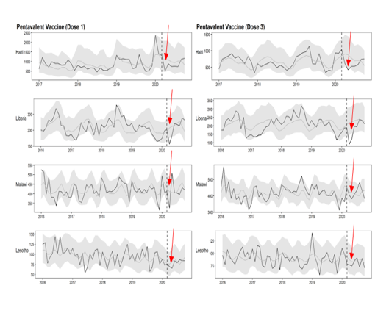
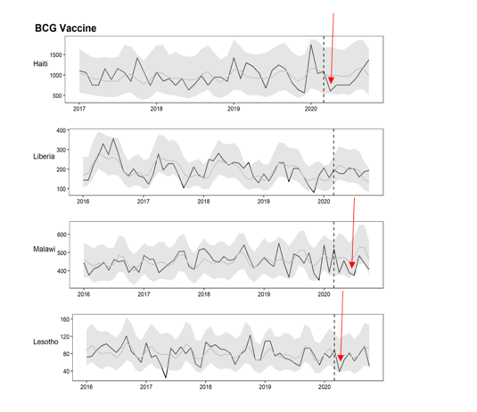
Communicating results: specific message
From Emma Boley and Emilia Connolly February 24, 2021 Presentation

Slide 8
Best practices

Slide 9
Lots of things to consider
Show the data
Ease comparisons across groups
Add color
Put on same scale
Align figures vertically / horizontally
Appropriate axis limits
Do not always need to include zero
Descriptive labels for plot features (axis, plot title, legend)
This is a good source (specific to ggplot in R): https://rafalab.github.io/dsbook/data-visualization-principles.html
But mostly I use ChatGPT for plotting code!
Notes:
I’m not going to go to into detail here

Slide 10
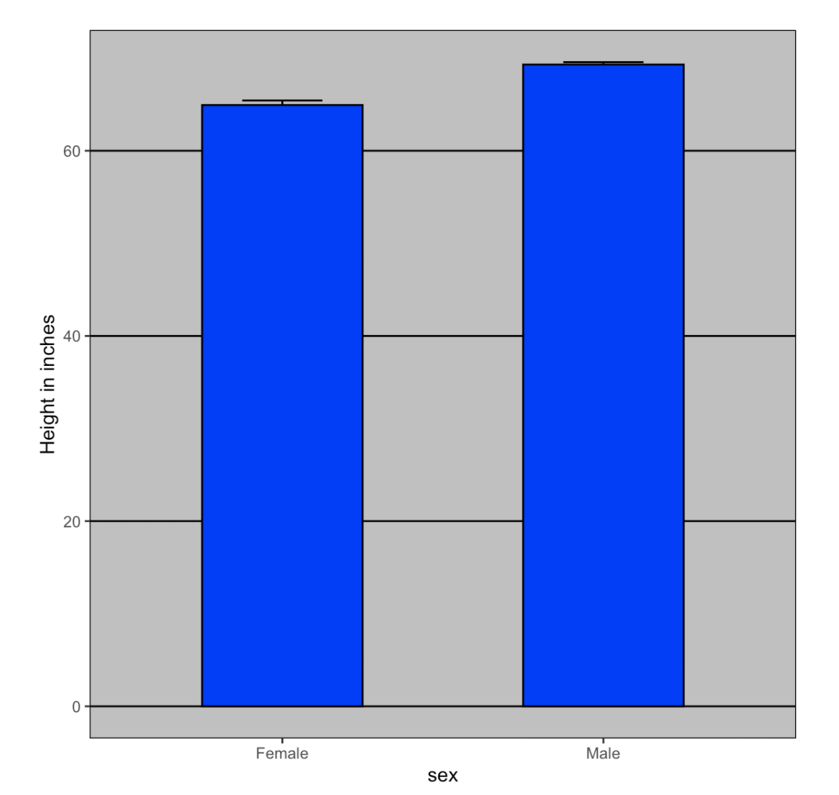
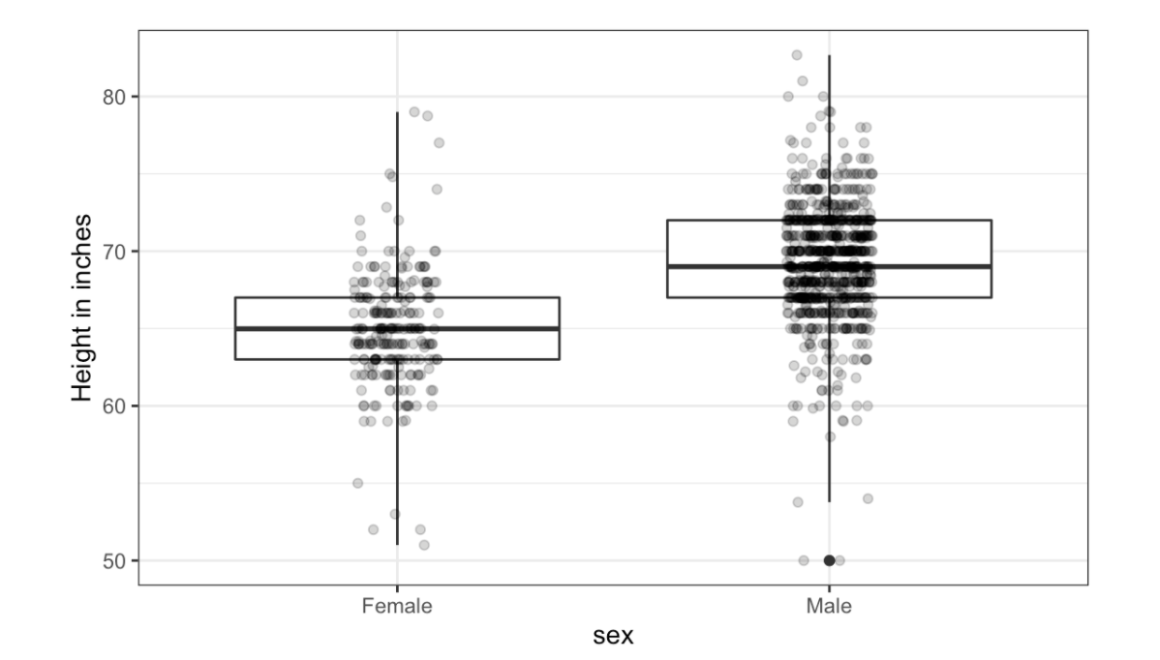
Show the data: “let the data speak!”
Notes:
Journals do not have colors

Slide 11
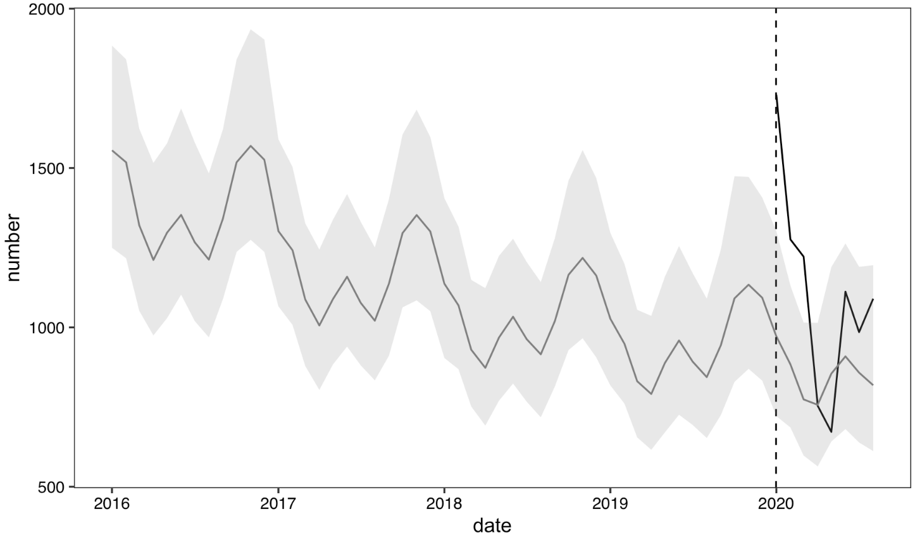
Show the data: be transparent

Slide 12
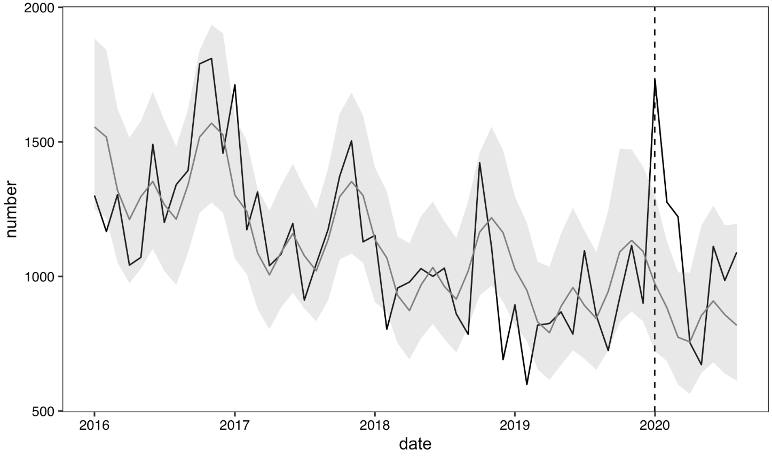
Show the data: be transparent

Slide 13
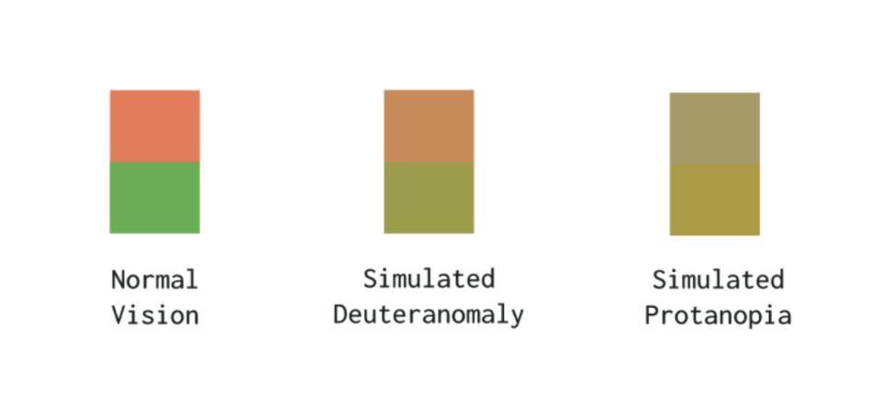
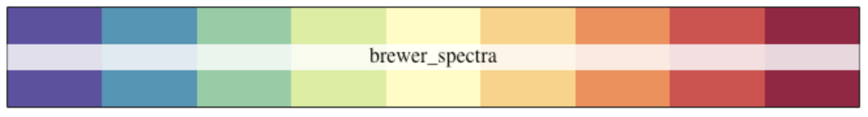
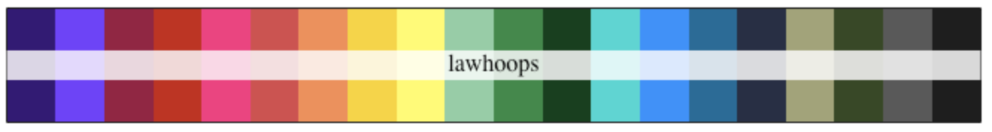
Choice of colors (or not!)
Consideration #1: Individuals with color vision deficiency
You can use a “vision simulator” to see what your plots would look like to people with color vision deficiency:
https://asada.website/webCVS/
Consideration #2: Color palettes are available online and can spruce up a figure!
Consideration #3: If you are publishing, color figures cost more.
Notes:
Color blind individuals (8% of men; 0.5% of women); Colors have different meanings; Color is not necessary for journals

Slide 14
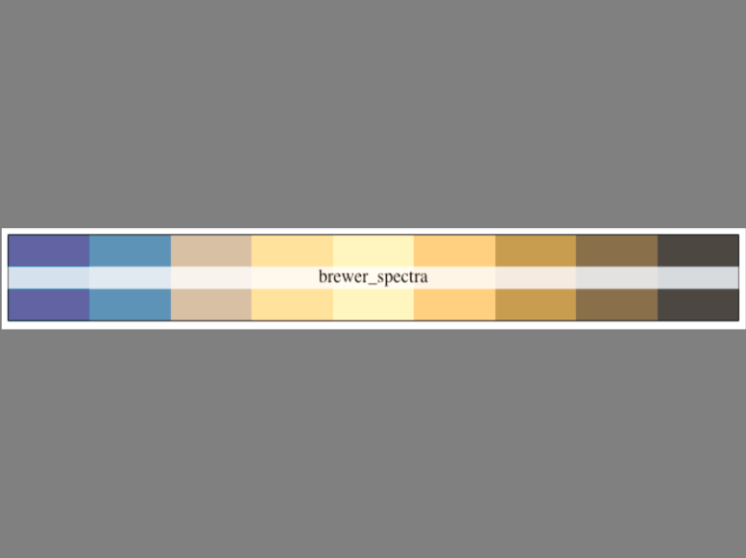
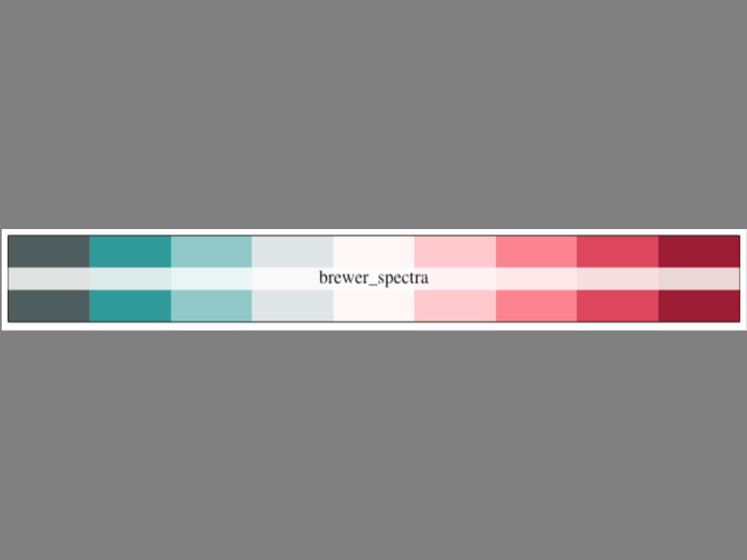
Choice of colors (or not!)
protanopia
tritanopia
I will not be using this color palette anymore!
Using the https://asada.website/webCVS/

Slide 15
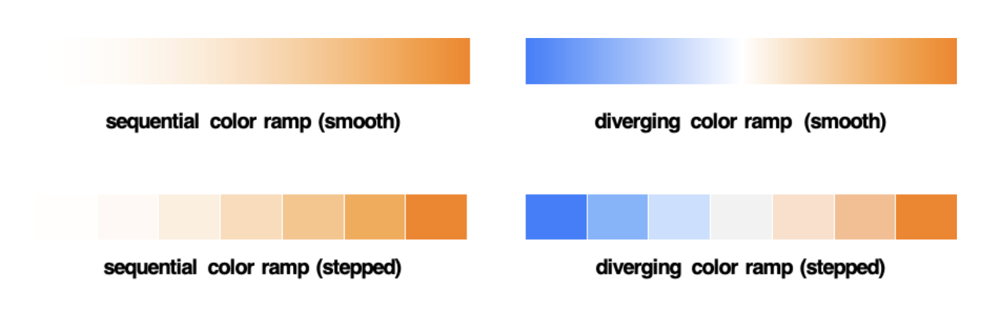
Choice of color scales
Is there a “neutral” value with one extreme?
Is there a “neutral” value with two extremes?
Best for continuous variable
Best for categorical variable
(but could be used for continuous)
Define min
Define max
https://www.storytellingwithdata.com/blog/2020/5/6/picking-the-right-colors
Notes:
As mentioned above, when using color to show quantities (as you might in a highlight table or a filled map), the differences in values are represented most often by changes in saturation and/or lightness.

Slide 16
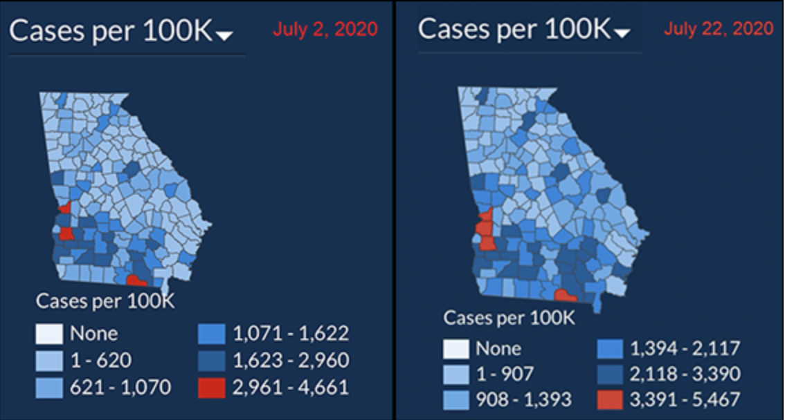
Choice of color scales
https://www.dailyposter.com/p/georgias-misleading-covid-map
Notes:
Specifically, as infection rates have skyrocketed, Kemp administration officials have shifted the color-coding of Georgia’s virus tracking map in ways that make it seem as if nothing is changing.

Slide 17
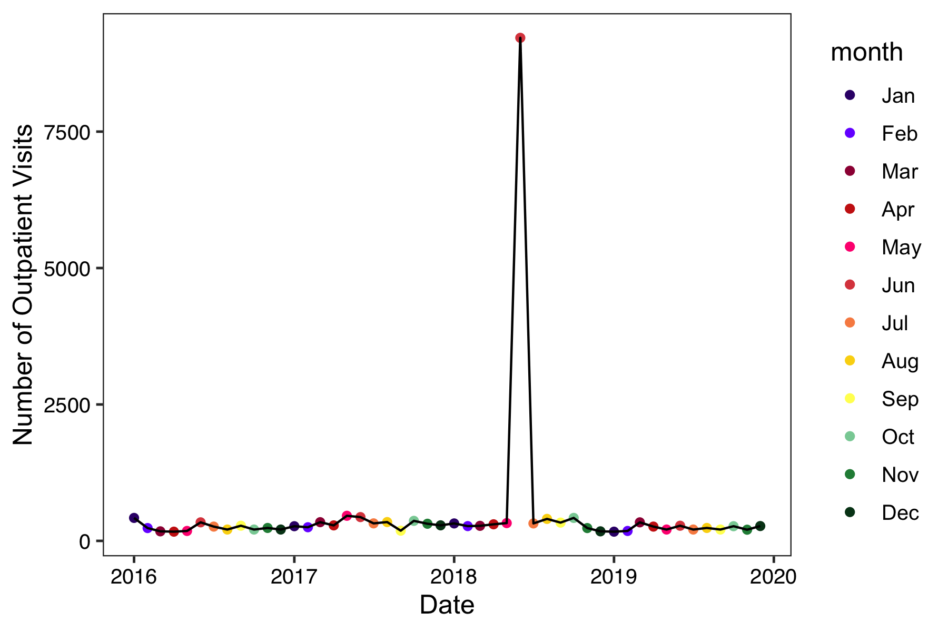
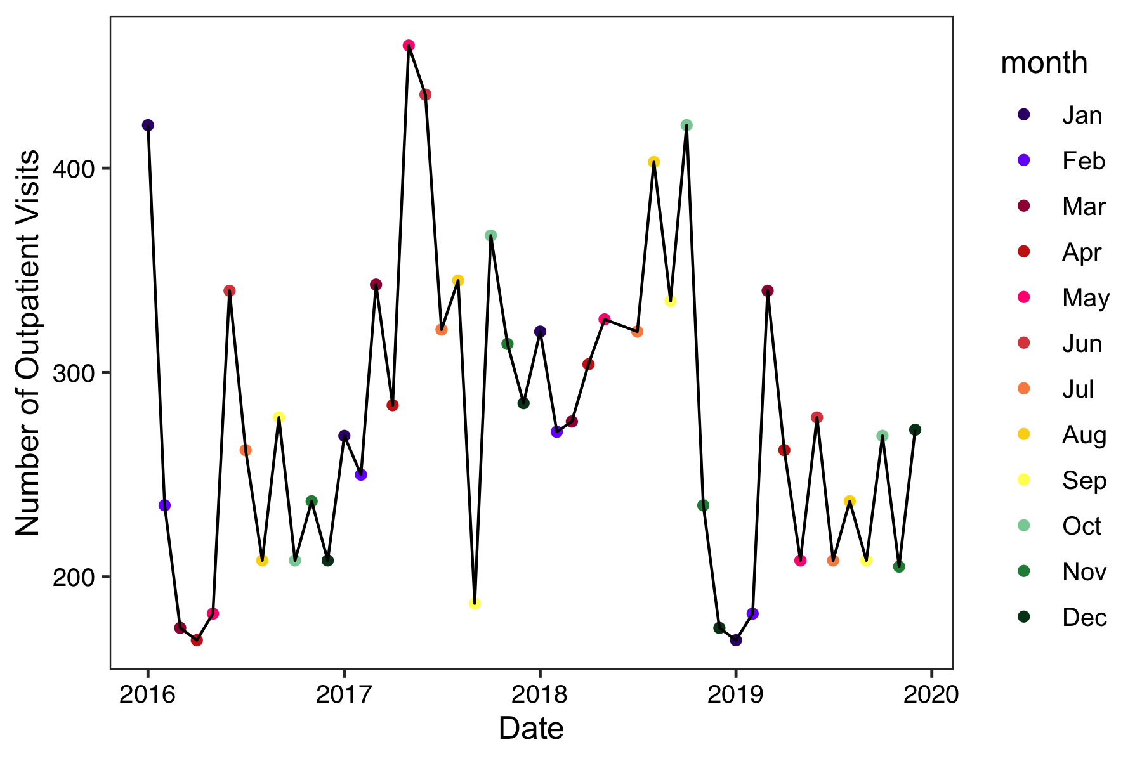
Appropriate axis limits
Outlier example from yesterday
Outlier removed
Notes:
Clutter; adjust plots - show example from last week

Slide 18
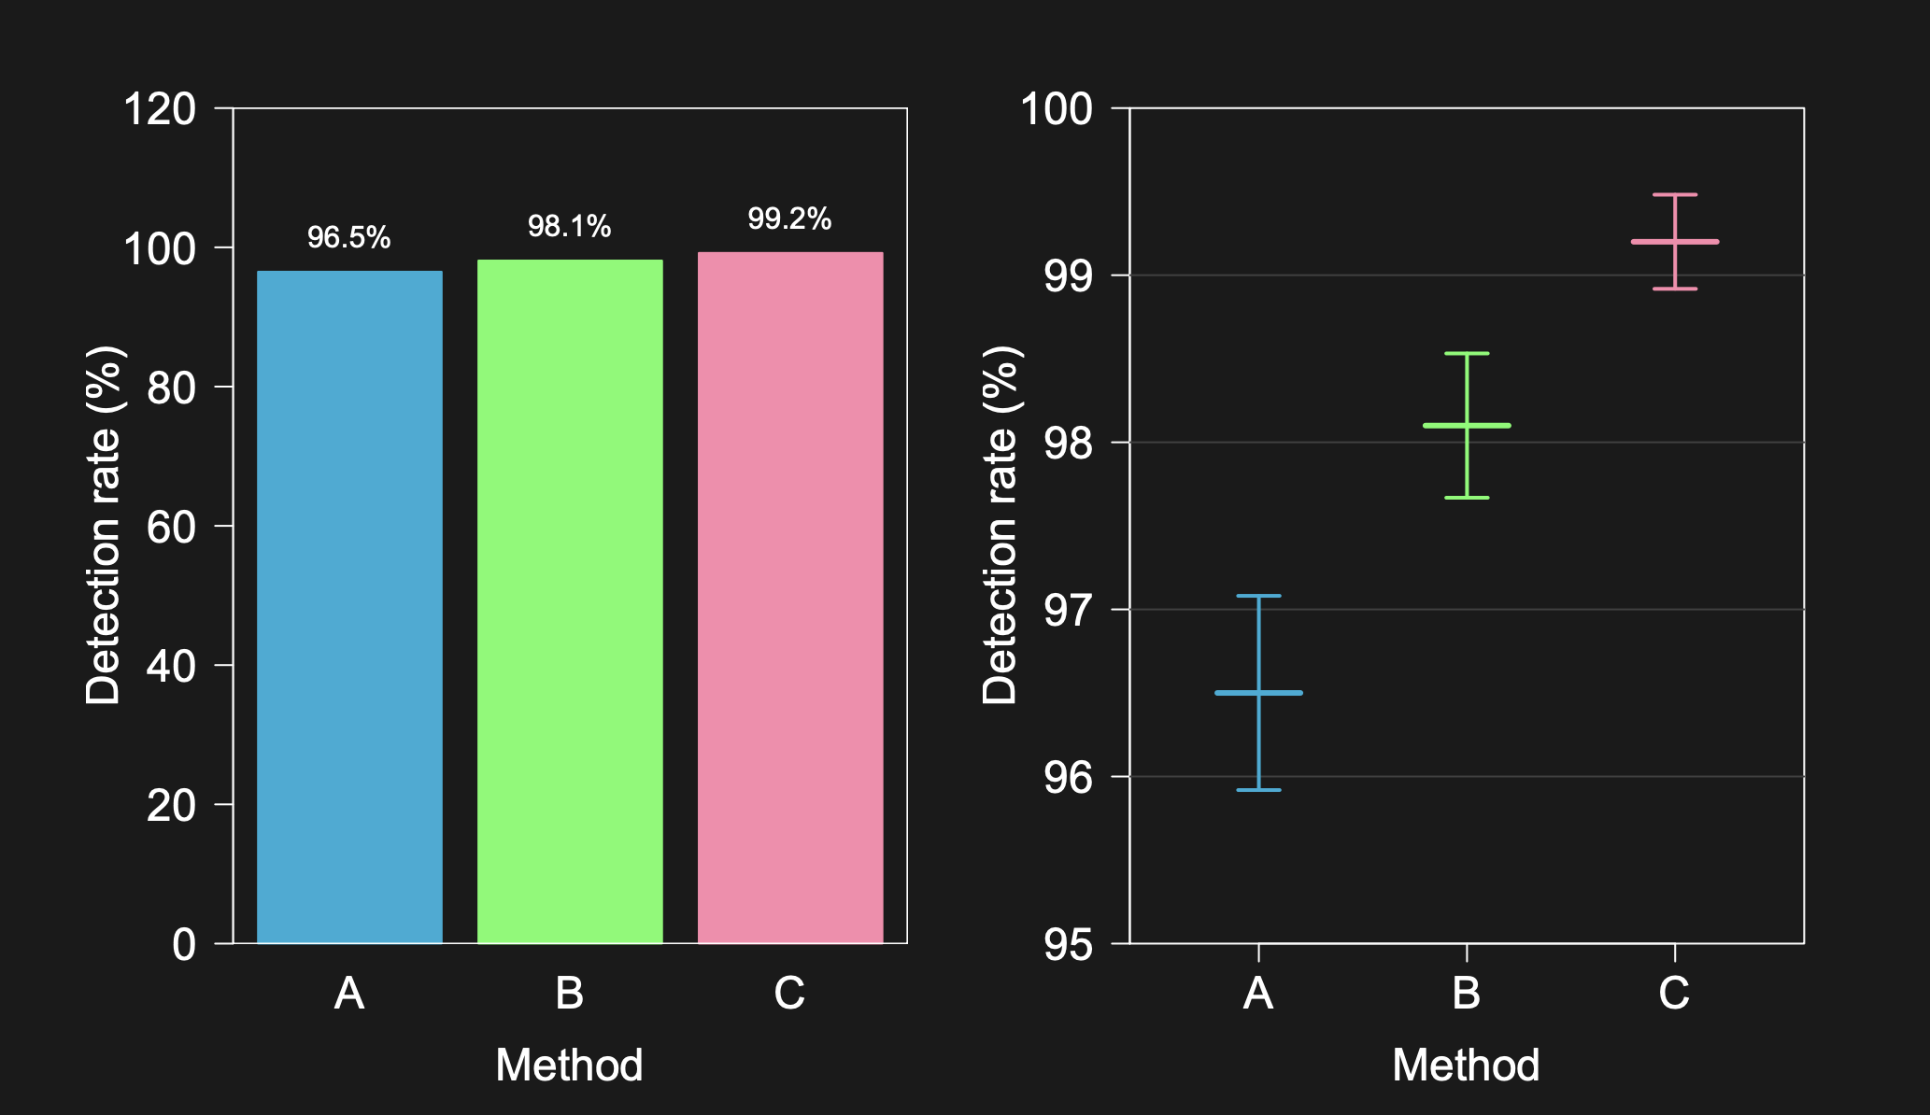
Appropriate axis limits
https://www.biostat.wisc.edu/~kbroman/presentations/graphs2017.pdf
Notes:
Clutter; adjust plots - show example from last week

Slide 19
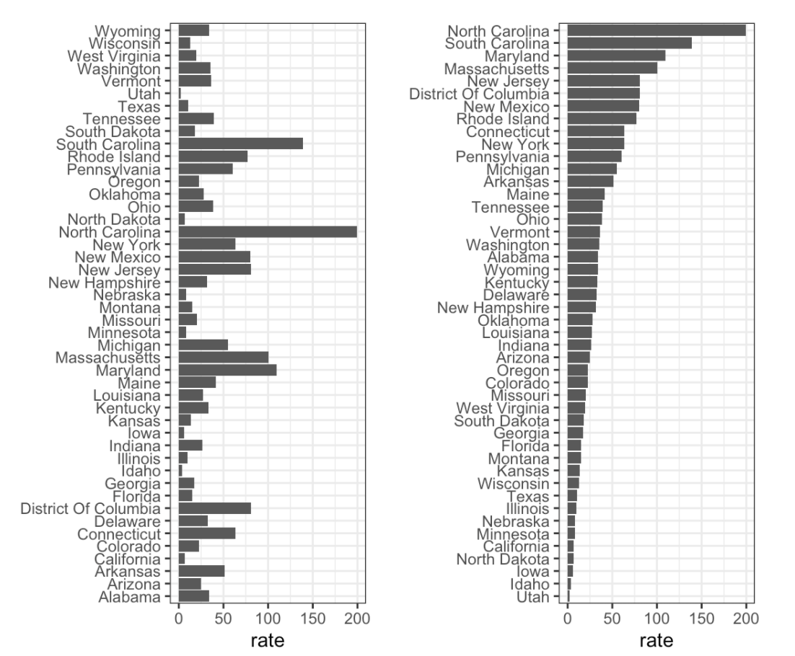
Activity: what plot do you prefer?
GOAL: Determine which are the best and worst states in terms of measles rates.
A
B
https://rafalab.github.io/dsbook/data-visualization-principles.html
Notes:
They provide the same information, so they are both equally as good.
The plot on the left is better because it orders the states alphabetically.
The plot on the right is better because it orders according to actual rate.
Neither plot. A different visualization would show this data better.

Slide 20
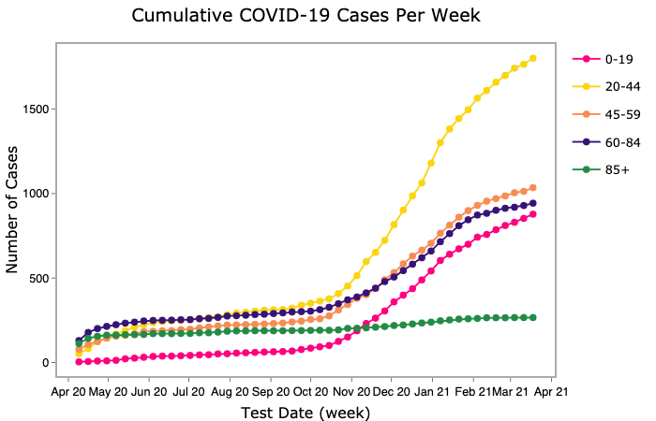
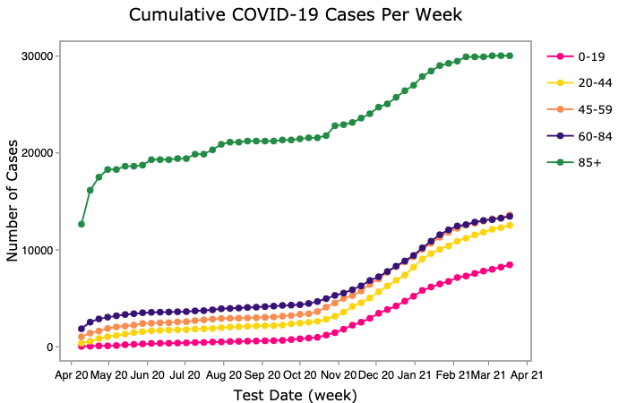
Activity: what plot do you prefer?
GOAL: Display which age groups have been the most impacted by COVID-19 during the entire pandemic.
A
B
Number of Total Cases
Number of Cases per 100,000

Slide 21
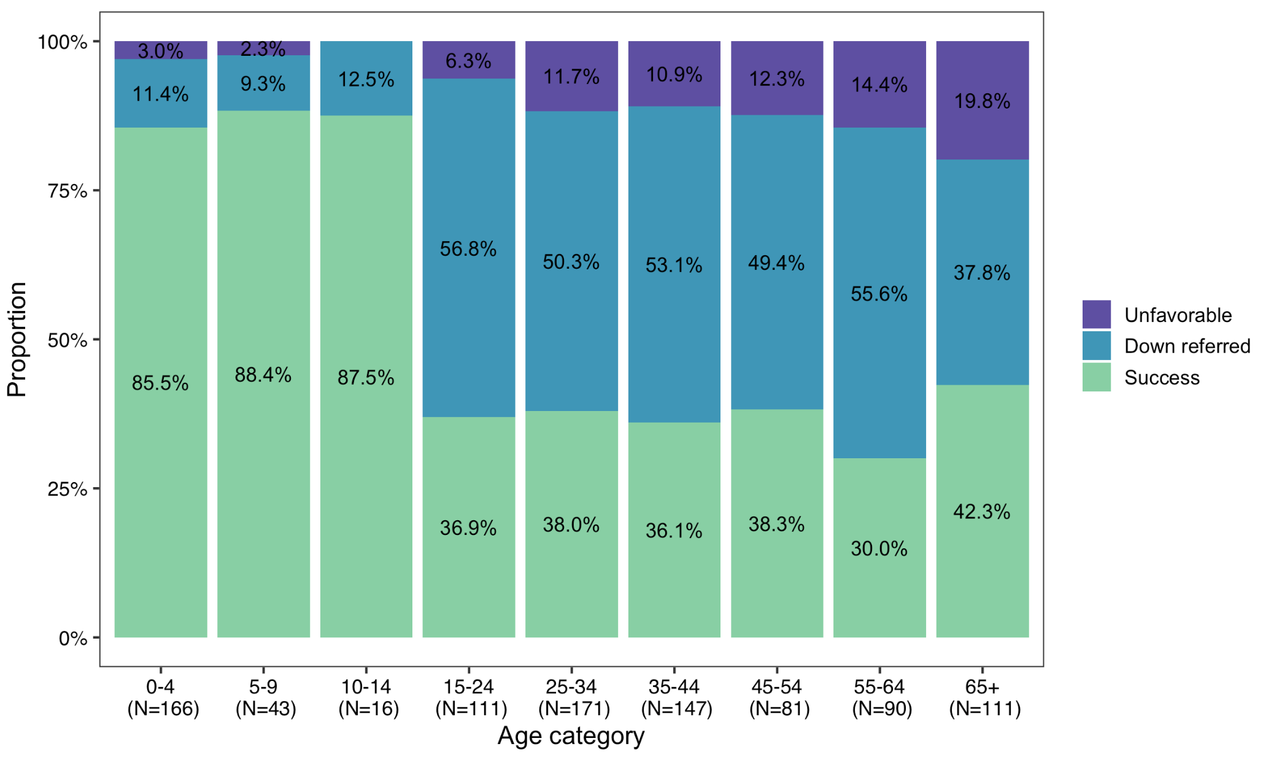
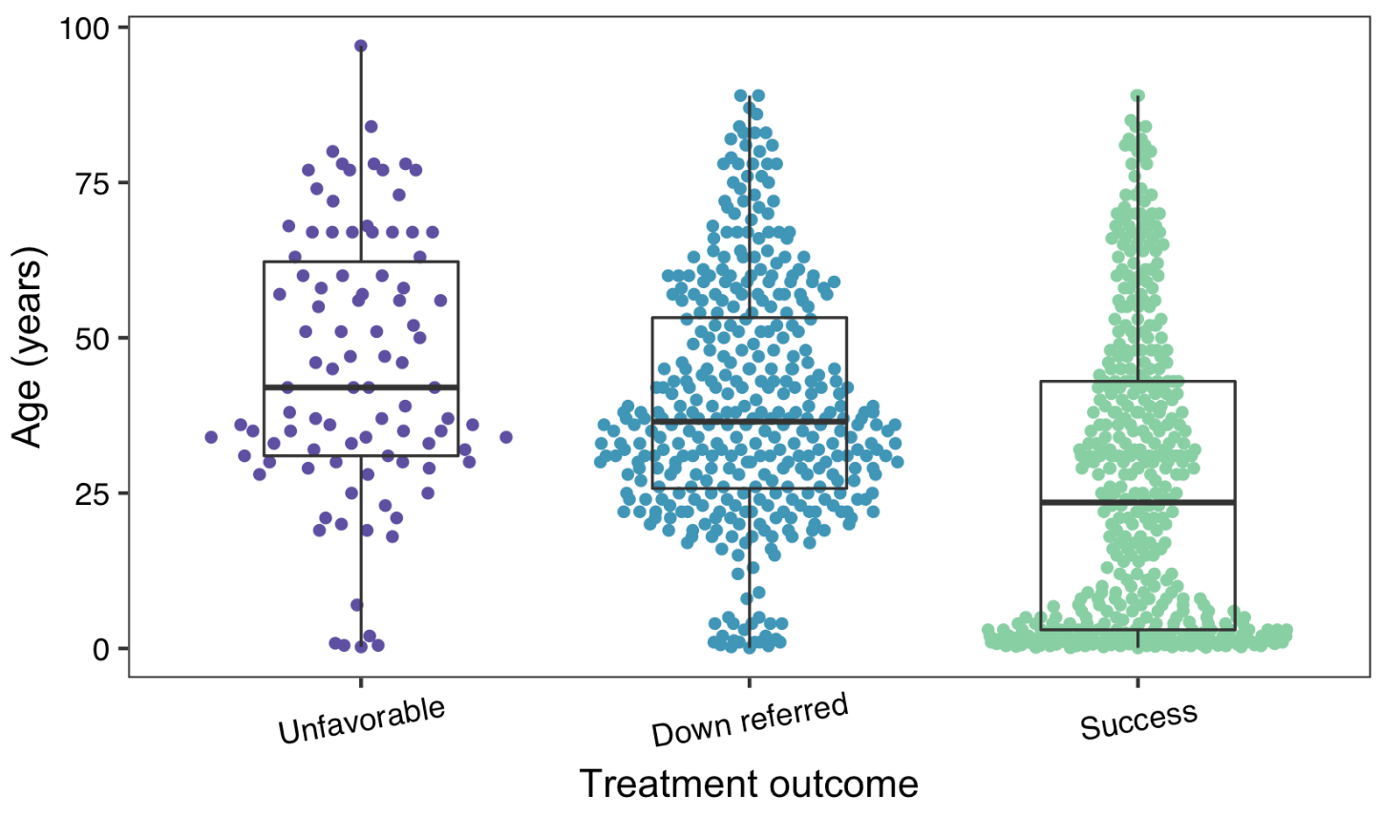
Activity: what plot do you prefer?
GOAL: Show how the rates of TB treatment outcomes differ by age.
A
B

Slide 22
Syndromic surveillance

Slide 23
Reasons for data visualizations
Exploring the data
Distribution of data / transparency
Identify patterns, outliers, missing data
Analyzing the data
Identifying deviations
Goodness of fit
Checking model assumption
Communicating results
Sessions 1 & 4
Sessions 2 & 3
Today’s focus!

Slide 24
Syndromic surveillance: communicating
The goal is to detect areas that have a potential uptick in cases
Want to communicate:
Is the deviation larger than expected?
Magnitude of the deviation
Is it important to show raw data and/or model fit?
Potential issues:
Need to contextualize the magnitude of deviation
Many areas or indicators to show (how to best compare?)

Slide 25

Time series plot – all information
count
Notes:
Facilitate the user’s analysis VS Communicate a specific message
Pros:
- All information about model fit and raw data is contained in here
Cons:
Difficult to interpret the exact magnitude of deviation
Lots of time points

Slide 26
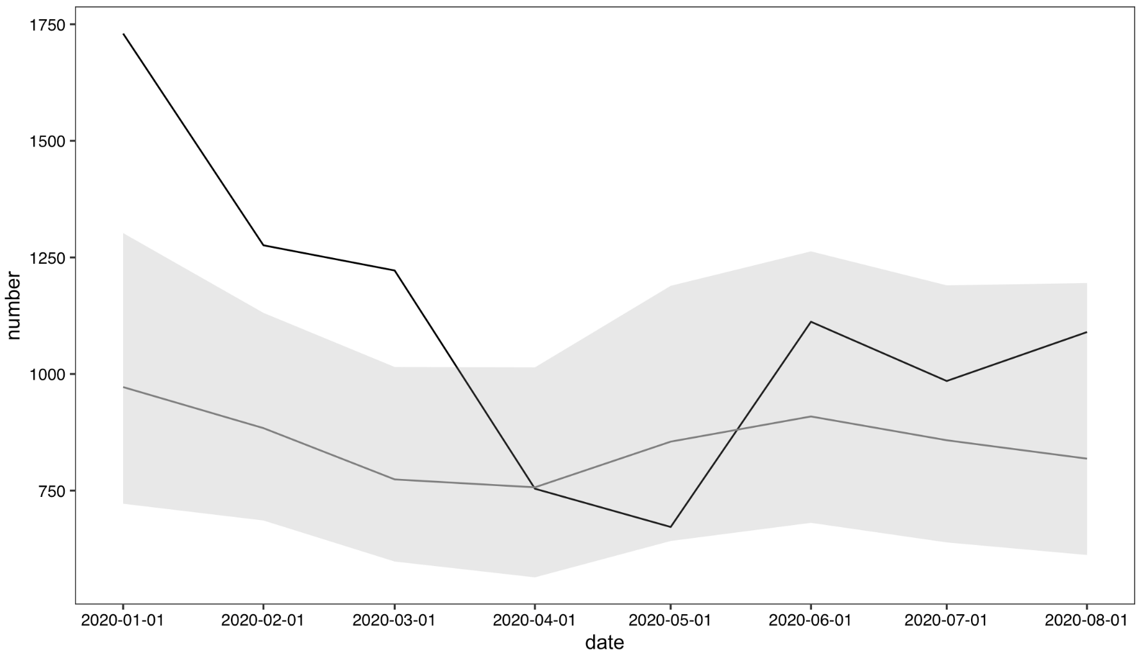
Time series plot – evaluation only
count
Notes:
We like showing the full plot to sites; however, once you have the model fit and feel good about it – there may not be any reason to show it again.

Slide 27
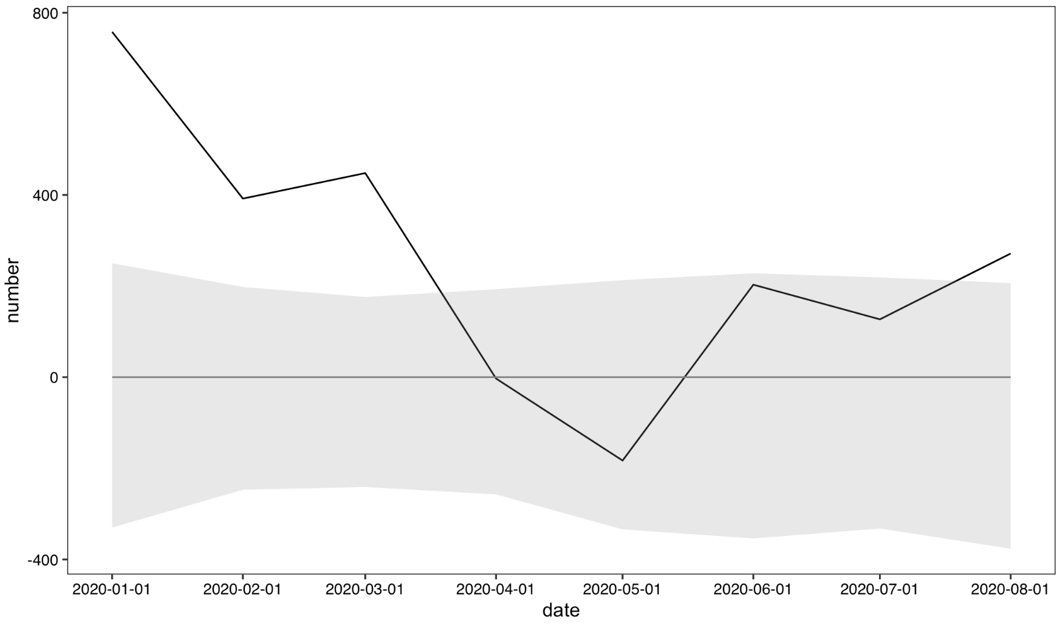
Time series plot – deviations
deviation
deviation = observed - expected

Slide 28
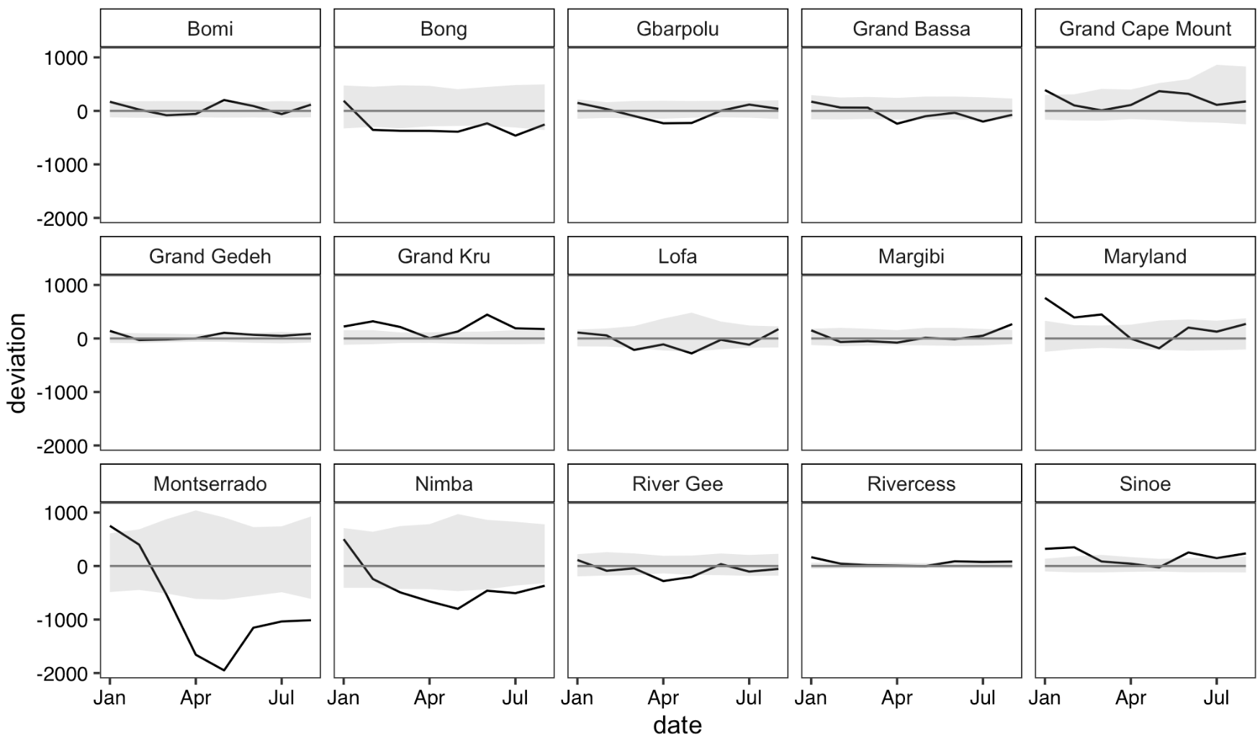
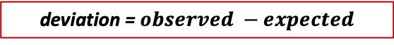
Multiple plots – deviations
deviation = $observed −expected$
Notes:
Skewed by Montserrado – hard to see what is happening elsewhere

Slide 29
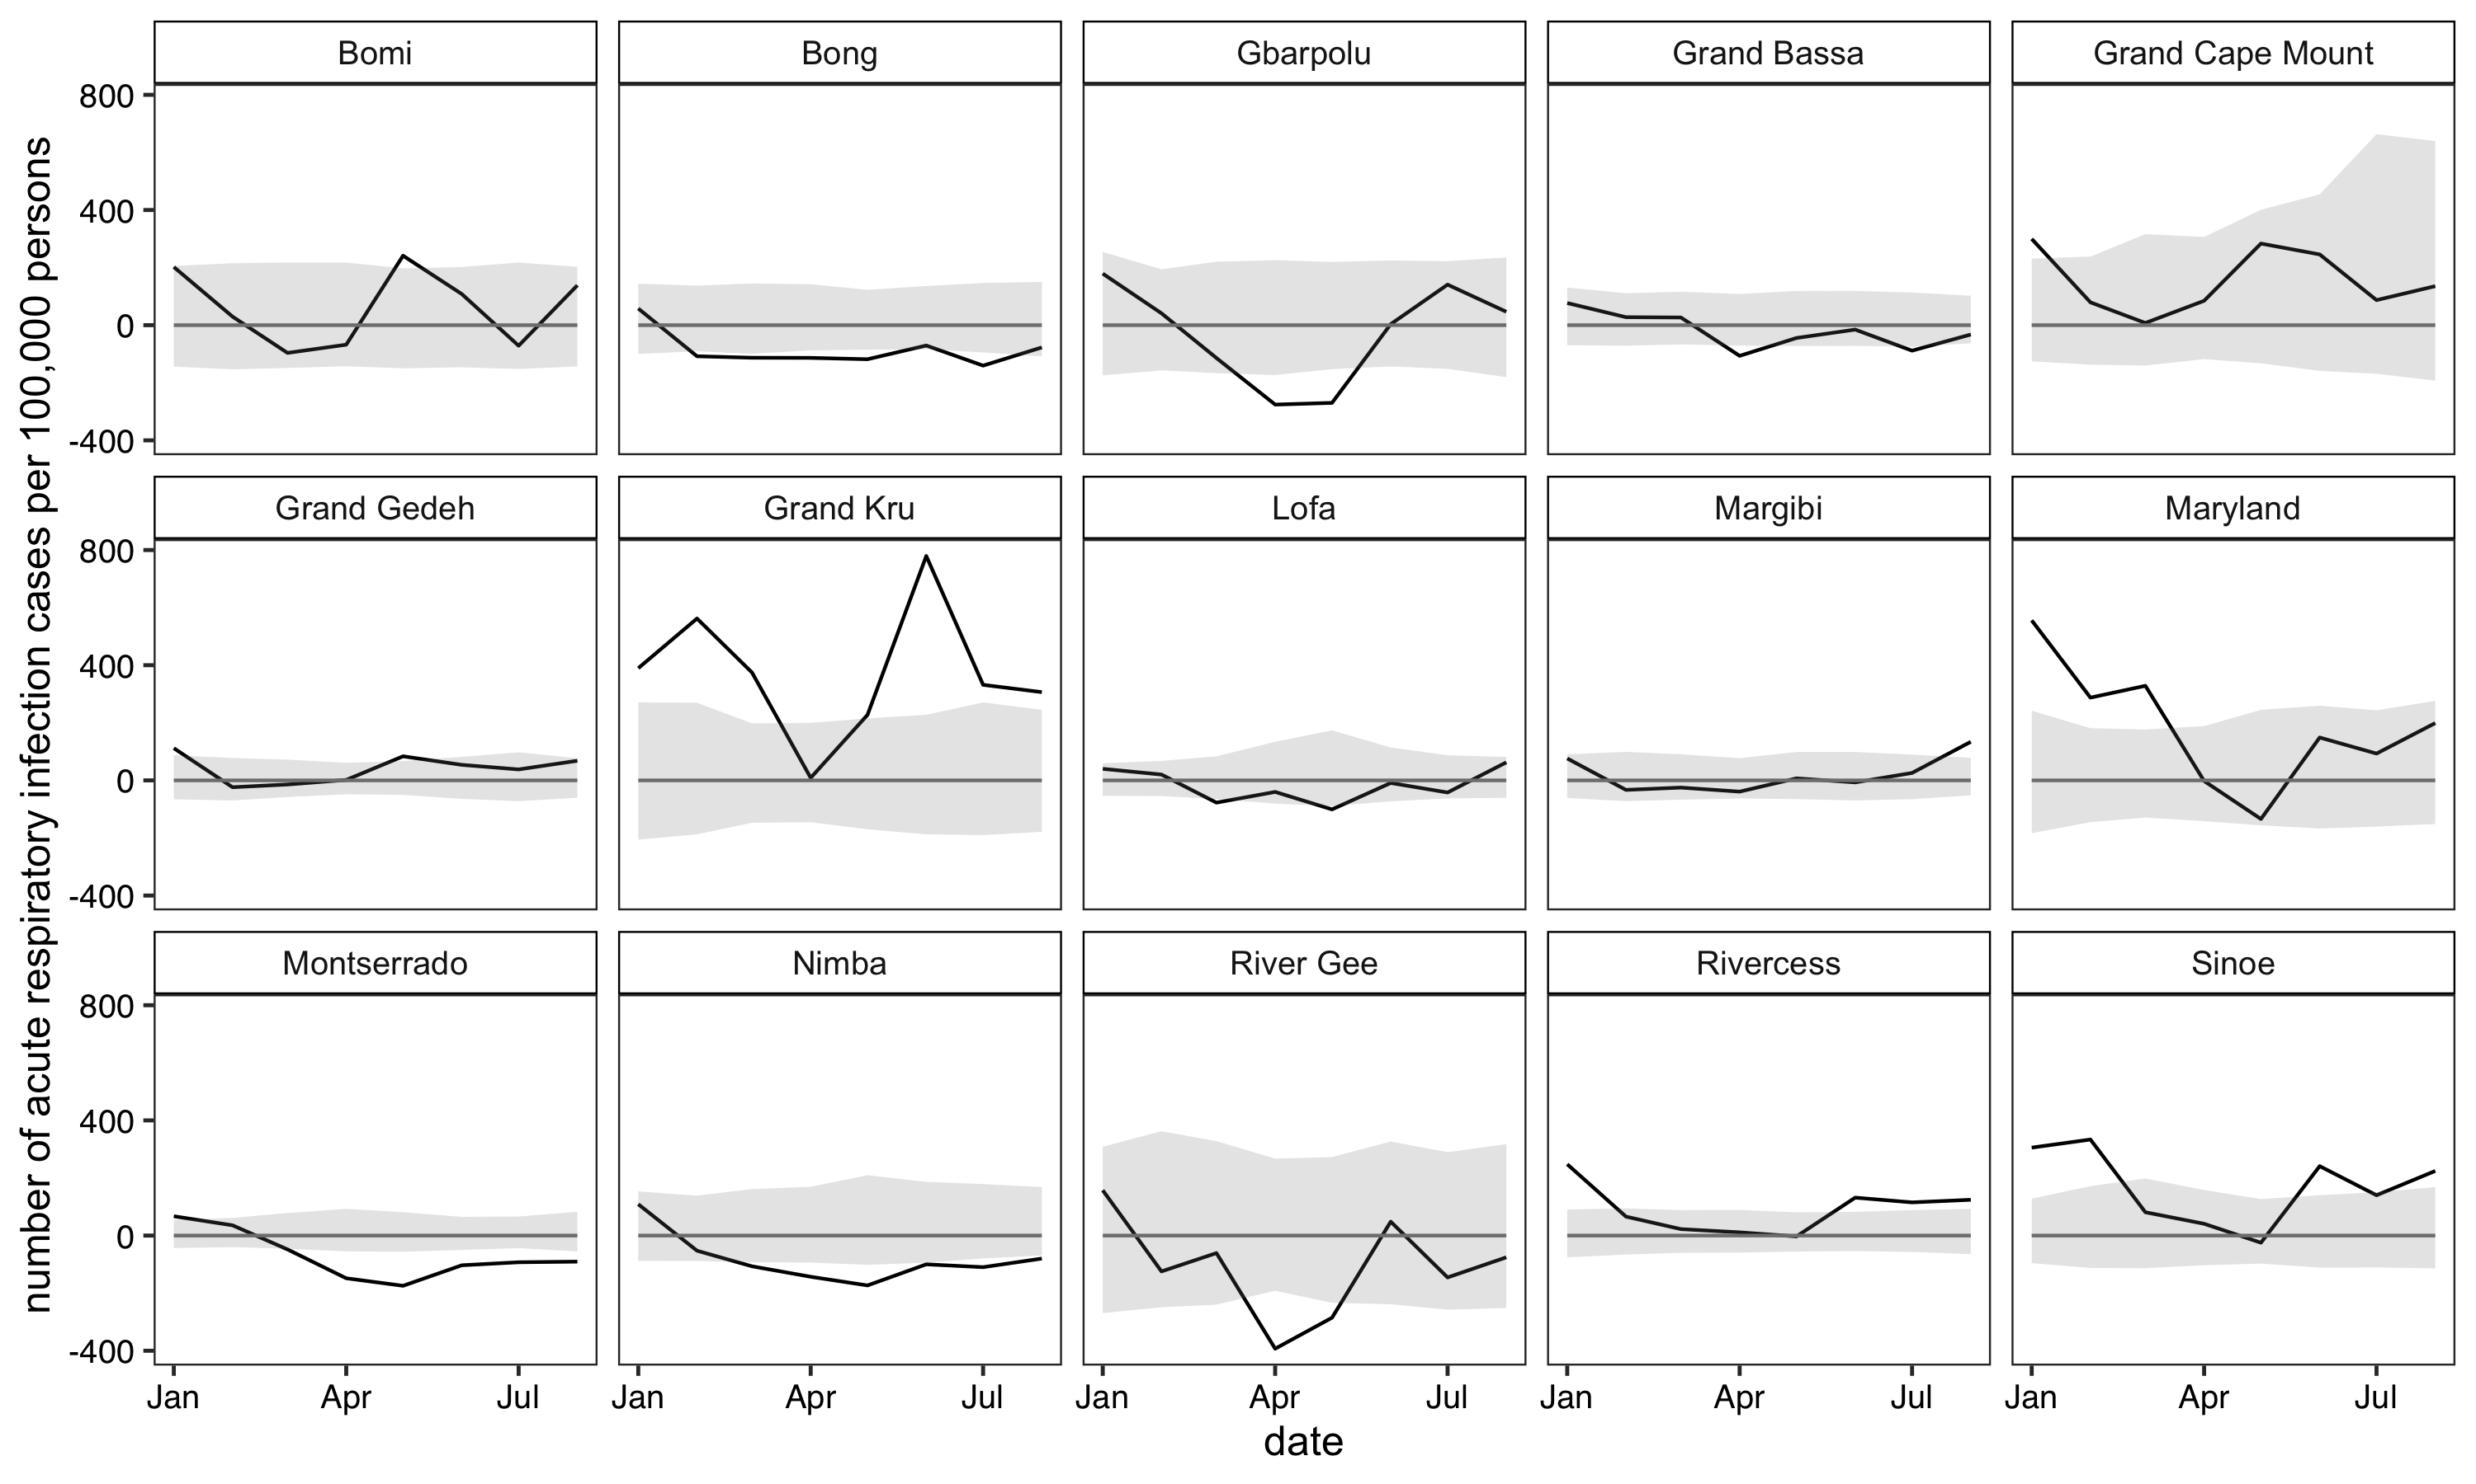
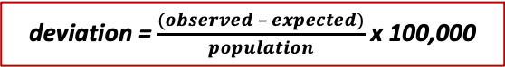
Multiple plots – standardized
deviation = $\frac{(observed – expected)}{population}$ x 100,000
Notes:
Requires that you have populatoin data for each county

Slide 30
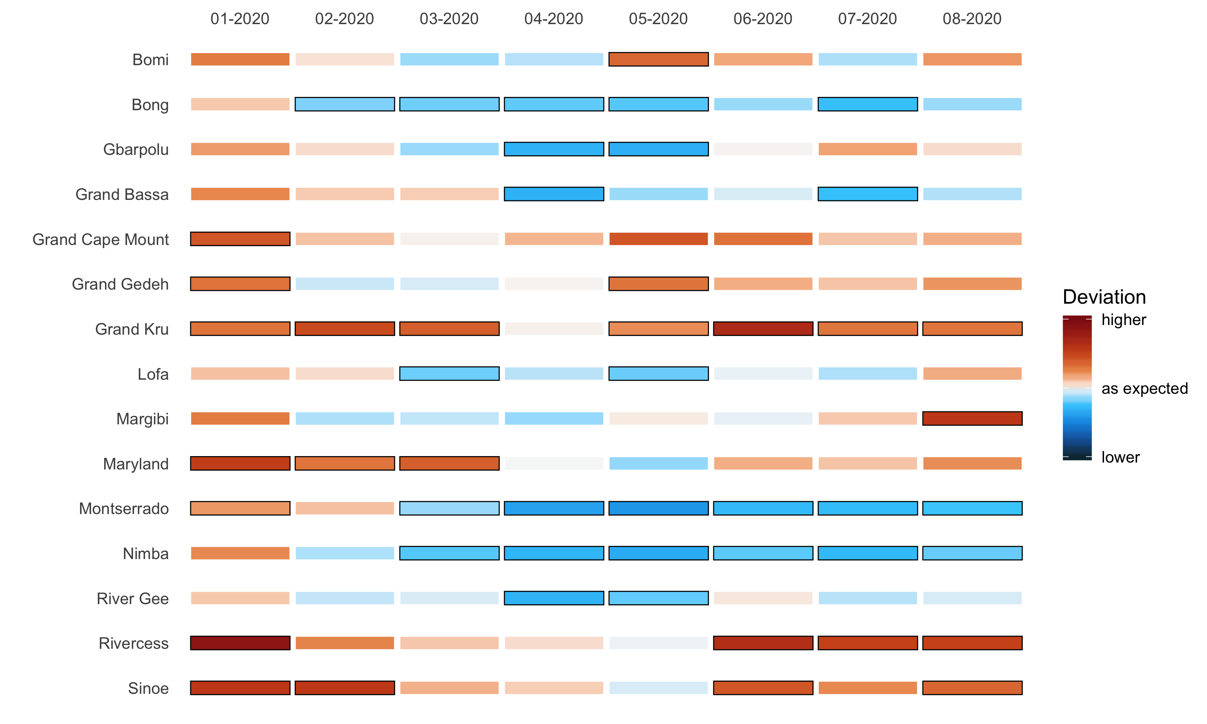
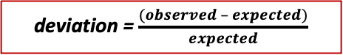
Tiled heat map
deviation = $\frac{(observed – expected)}{expected}$
Notes:
Black boxes indicate that they fall outside predicted intervals
Tricky is the scale can change over time, so you need to think of how to deal with this beforehand

Slide 31
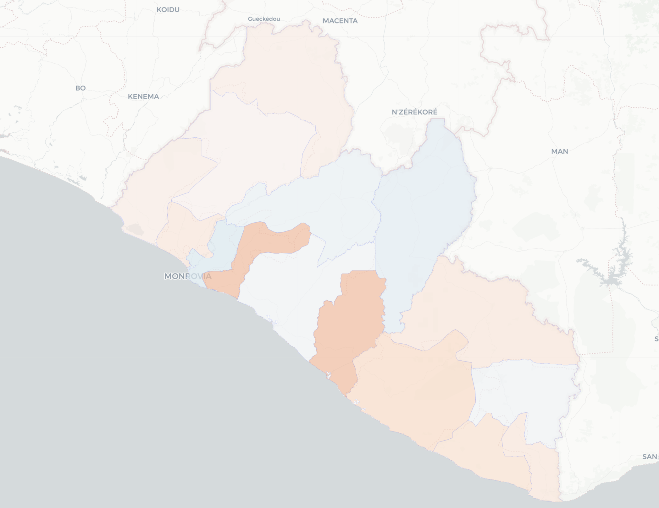
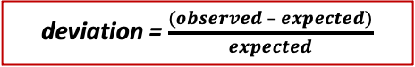
Map – static
deviation = $\frac{(observed – expected)}{expected}$

Slide 32
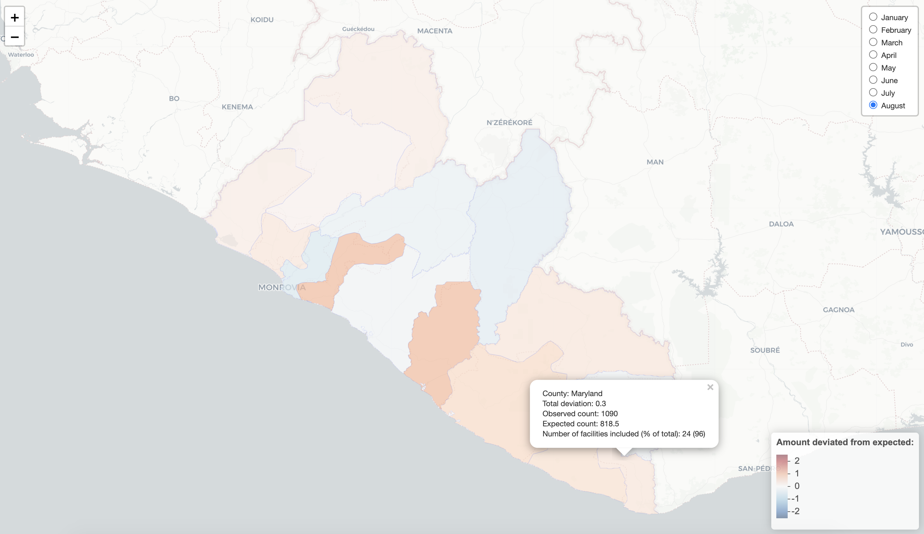
Map – interactive
Created by Nichole
deviation = $\frac{(observed – expected)}{expected}$

Slide 33
Software for data viz
Figures can be generated in most software we use for data analysis (R, Python, Stata, SPSS, SAS, and Excel)
R is free and has the *best* data viz options via the ggplot2 package
Interactive options in R include:
Rmarkdown to create HTML files (plotly package for interactive plots)
Shiny app
leaflet package for mapping (Nichole is an expert)
When creating dashboards, Shiny requires strong knowledge of R. Another more user-friendly option is Tableau ($$).

Slide 34
Lab: Tying it all together!
Lab will be a large activity to work through all skills from course
Syndromic surveillance: Choose from three options
Ample time to fine tune data visualizations & ask specific questions

Slide 35
Thank you!

